Slide 1
Lycophytes (the earliest still extant tracheophyte lineage, arising at least 400 MYA) & Ferns (Monilophytes)
Judd et al pp. 185-206

Slide 2
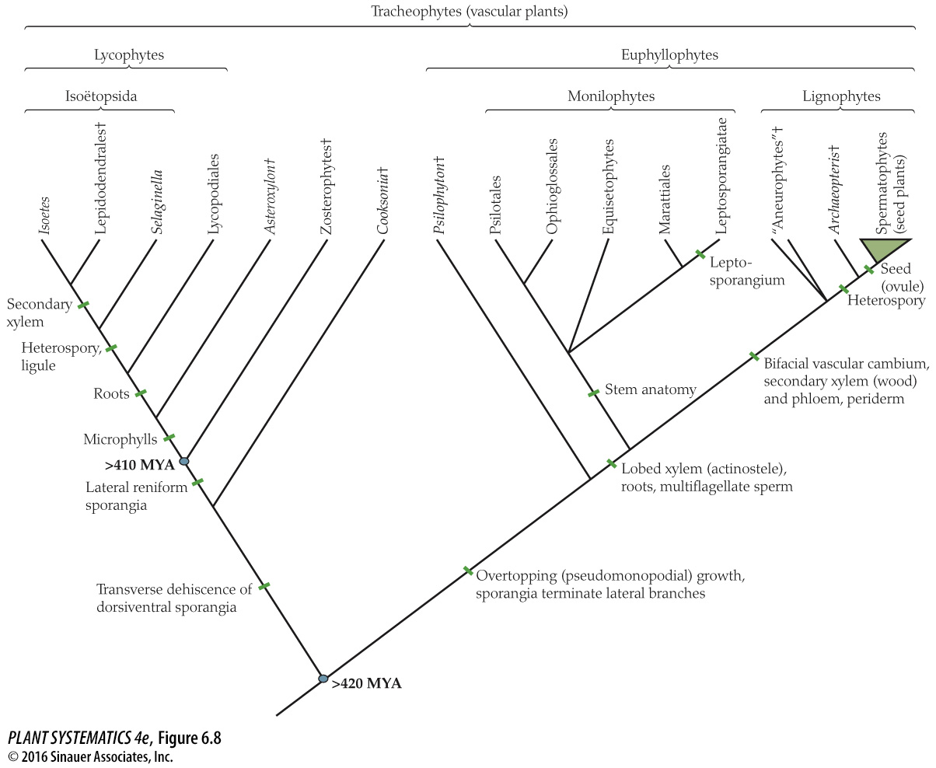
No longer two equal branches
Modern lycophytes have a single sporangium per leaf. Gametophytes are usually subterranean.
Lycophytes are the chief components of North American and European coal deposits.

Slide 3
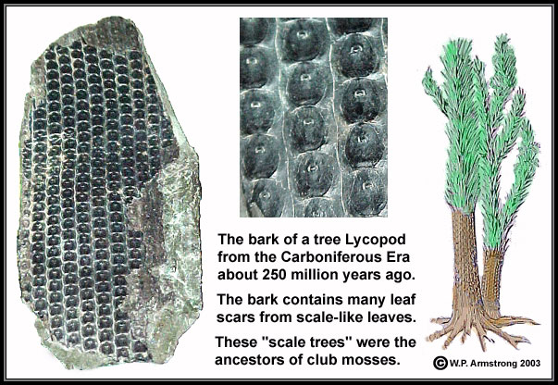
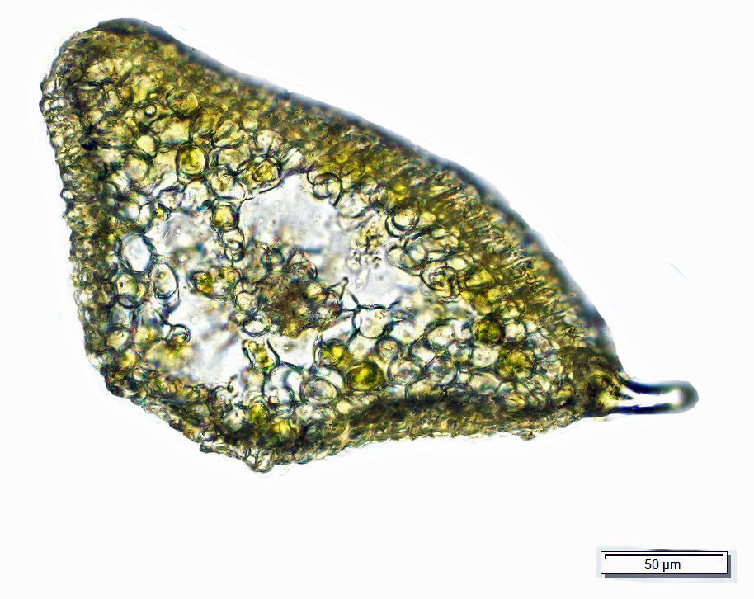
Selaginella leaf cross section

Slide 4
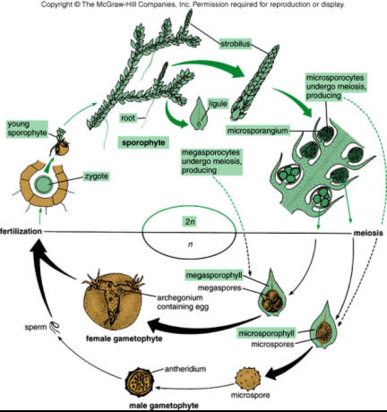
Lycophyte Life Cycle
Alternation of generations– note that the gametophyte generation is already much reduced from the mosses!
Sporophyte dominant life cycle
Heterosporous-> producing two types of spores (large (megaspores) and small microspores)
Sperm must swim to egg in archegonium

Slide 5
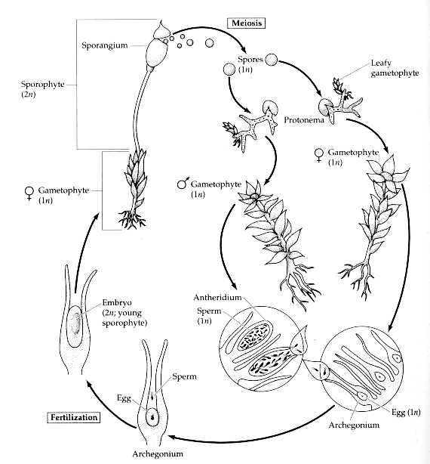
Moss Life Cycle
Gametophyte dominant life cycle
Sporophyte is
completely dependent on Gametophyte

Slide 6
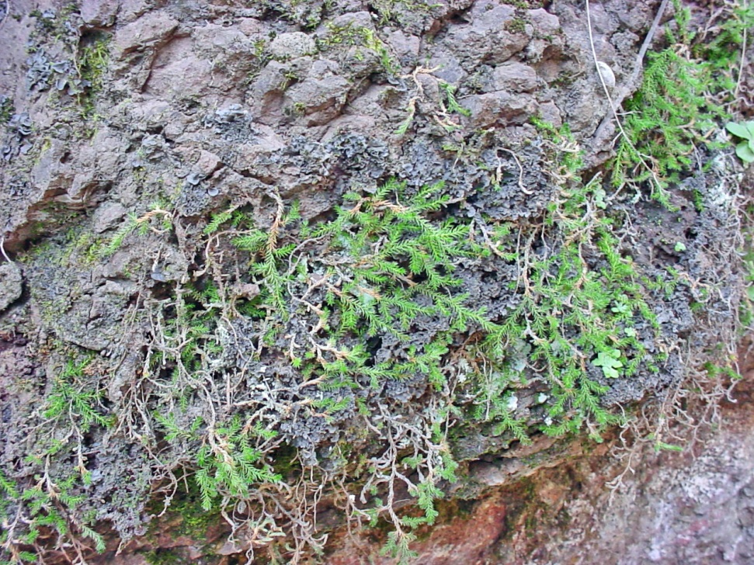
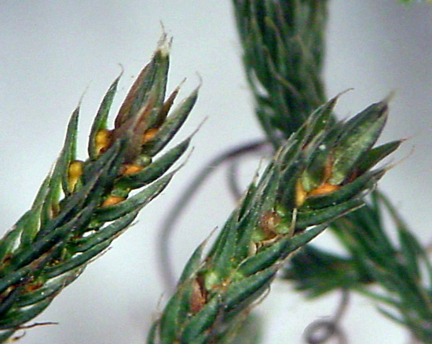
Selaginella underwoodii
Growth habit
Fertile frond (strobilus)
4-ranked, at end of branches: heterospory– produces two types of spores, micro- and megaspores like the angiosperms do. Ferns are mostly homosporous. Heterospory is a great evolutionary achievement.
This is the sporophyte
Notes:
The Selaginella sperm must swim through the water-film up the rhizoids and into the cracked megaspore wall to reach the megagametophyte inside

Slide 7
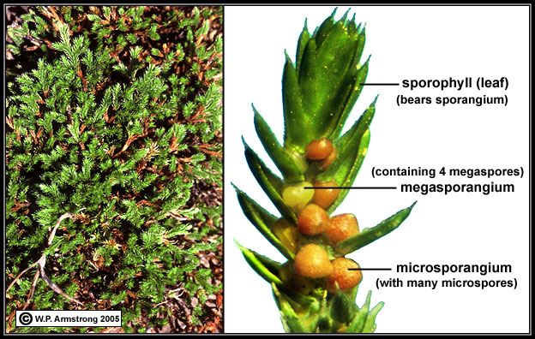
Selaginella
Selaginella– sporangia in the leaf axils, heterosporous.

Slide 8
Lycophytes– Selaginella (Spike Moss)
First extant group beyond bryophytes
Xylem with tracheids, and tracheids are strongly lignified (vascular system)
Gametophyte greatly reduced compared to bryophytes
The remains of lycophytes account for our major coal deposits. Some became large trees.

Slide 9
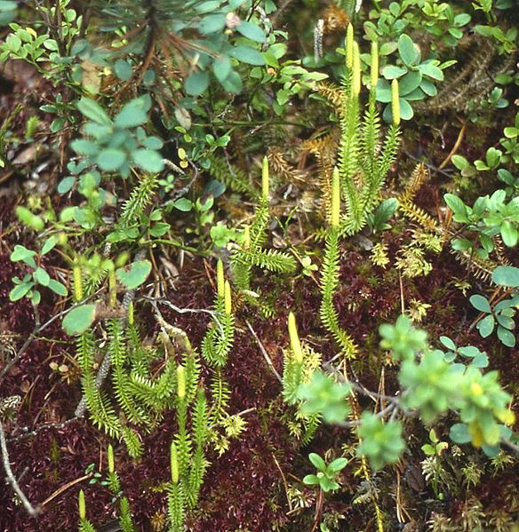
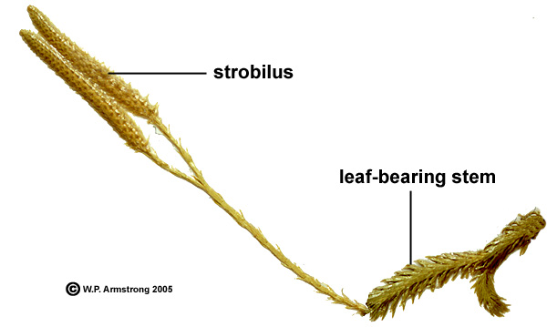
Lycopodium annotina
(Lycopodiaceae)

Slide 10
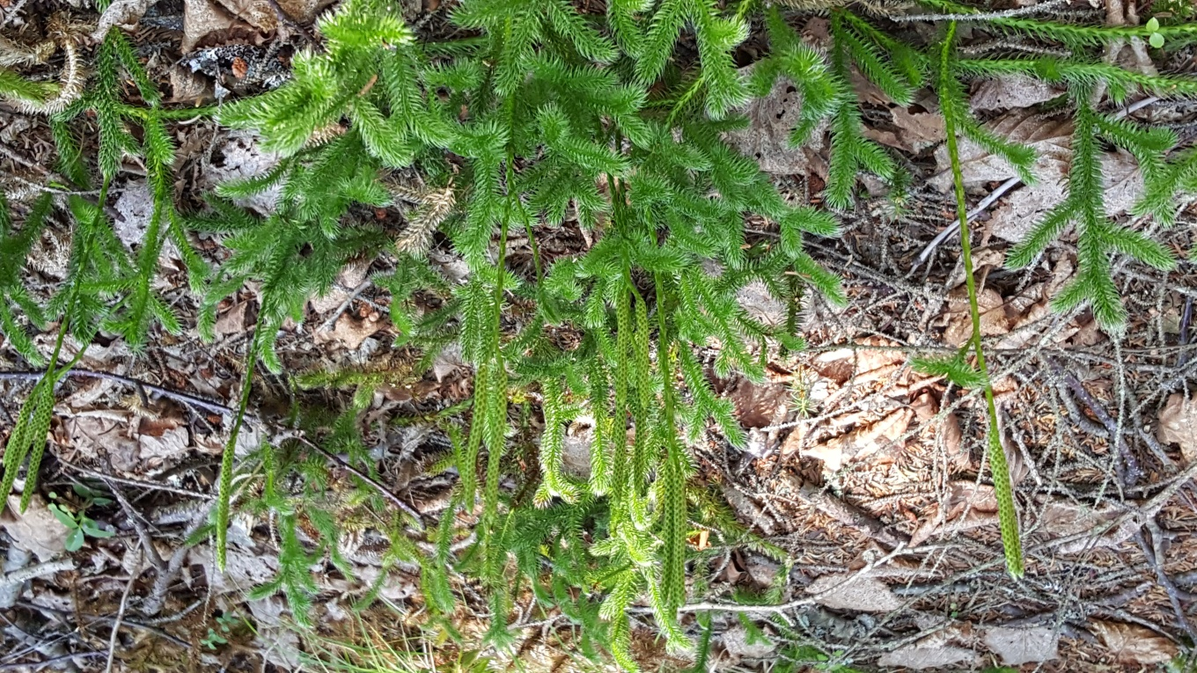
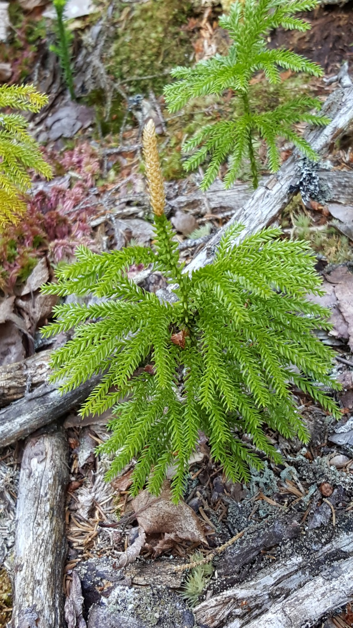
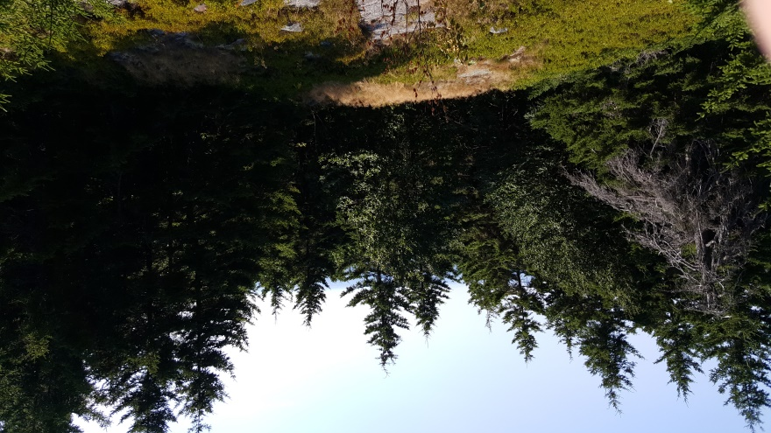
Lycopodium in Maine

Slide 11
On to Ferns (Monilophytes)
Differentiation between a main axis and side branches
Large leaves compared to Lycophyte microphylls (large leaves have evolved independently multiple times)
Three major lineages: Marattiales (early divergent clade with massive rootstocks and large fronds), Ophioglossales (blades separate from fertile fronds, underground gametophyte), and Leptosporangiate ferns (most of what we think of as modern day ferns).

Slide 12
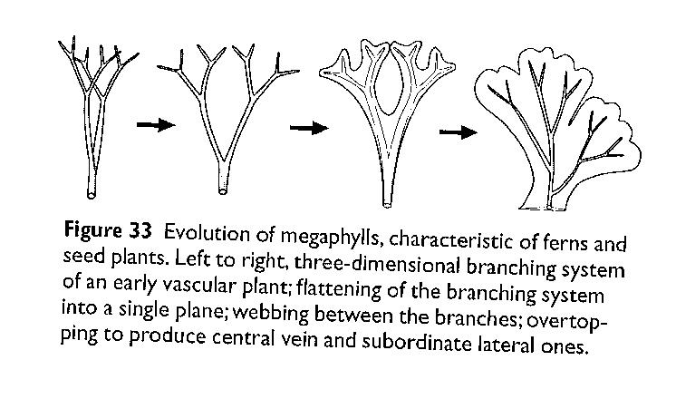
Evolution of Megaphylls
From Moran: A Natural History of Ferns

Slide 13
Major Fern Lineages
Marattiales & Ophioglossales are eusporangiate ferns: retain ancestral condition of sporangium with mature wall that is more than one layer thick.
Leptosporangiate ferns are the more common ones we know and are characterized by derived development with mature sporangium wall only one cell thick.

Slide 14
Major Fern Lineages
Marratiales– plants of the wet tropics, not represented here.
Ophioglossales– separate sterile and fertile segments: Botrychium, might be here but not yet found in the Gila!
Leptosporangiatae– about 40 known in the Gila.
Lesser groups: Equisetophytes, Psilotales

Slide 15
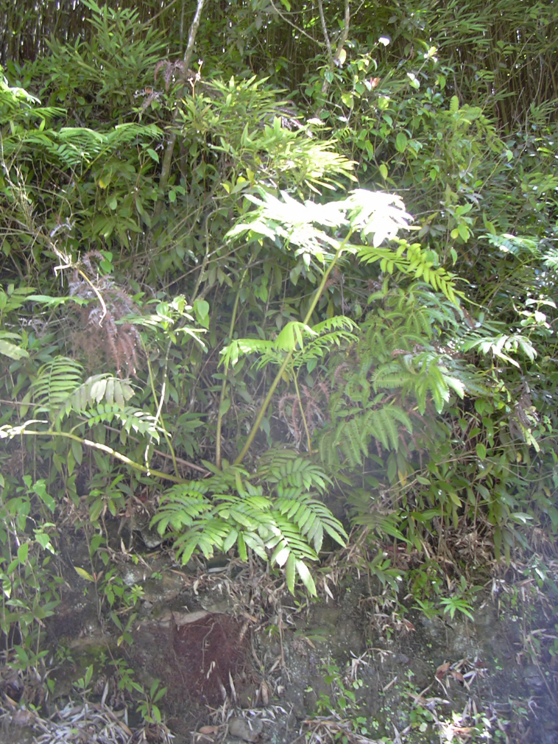
Marattiales
Angiopteris evecta (Mule’s Foot Fern) native to Australasia, Madagascar and Oceania. Big fronds, large rootstock.

Slide 16
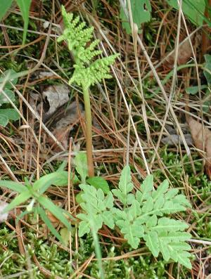
Ophioglossales
Botrychium (Moonwort)
Separate vegetative and fertile fronds; gametophyte is underground.

Slide 17
Leptosporangiate Ferns
Sporangium– contains usually 32 or 64 spores. Sporangium wall is 1 cell layer thick, has a stalk, and ring of cells called the “annulus” through which they rupture to catapult spores.
Sporangia grouped into clusters called “sori” on the underside of leaves.
Shape and orientation of sori frequently useful in separating genera of ferns.
Sori often covered by flap of tissue called the “indusium.” Shape of indusium also useful in determining genera.

Slide 18
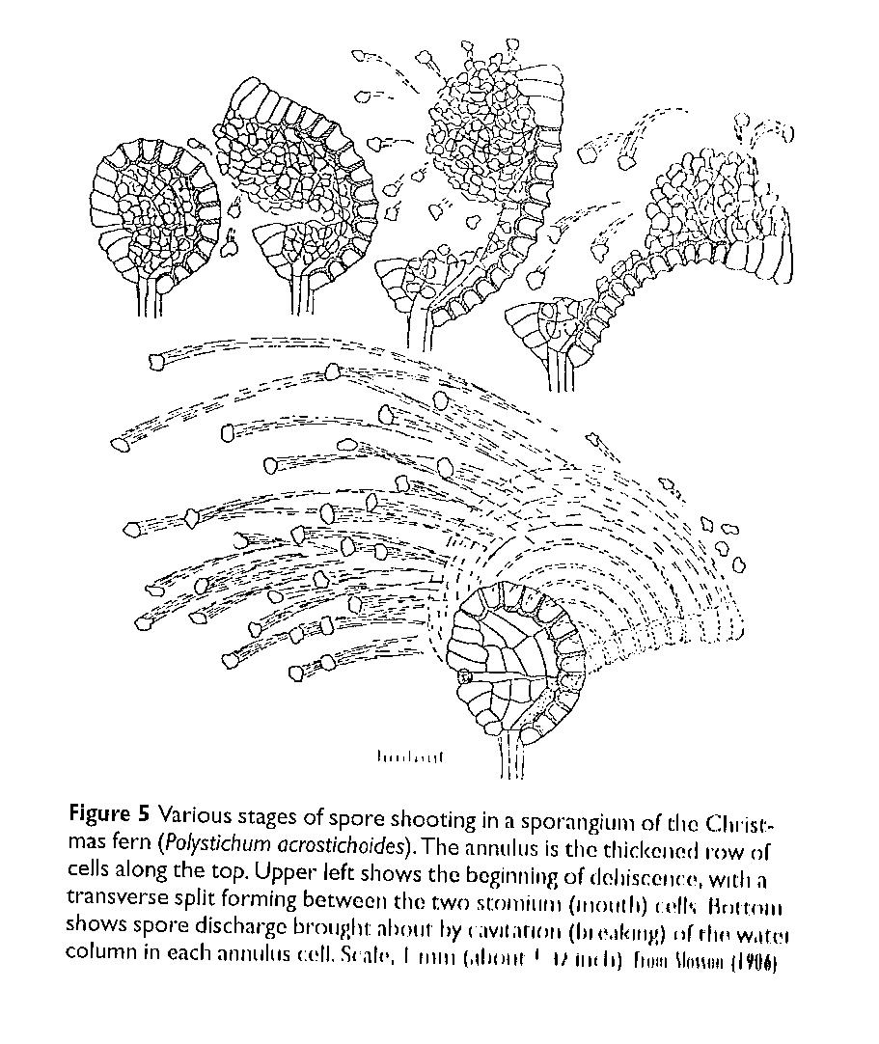
Spore Shooting
From Moran: A Natural History of Ferns

Slide 19
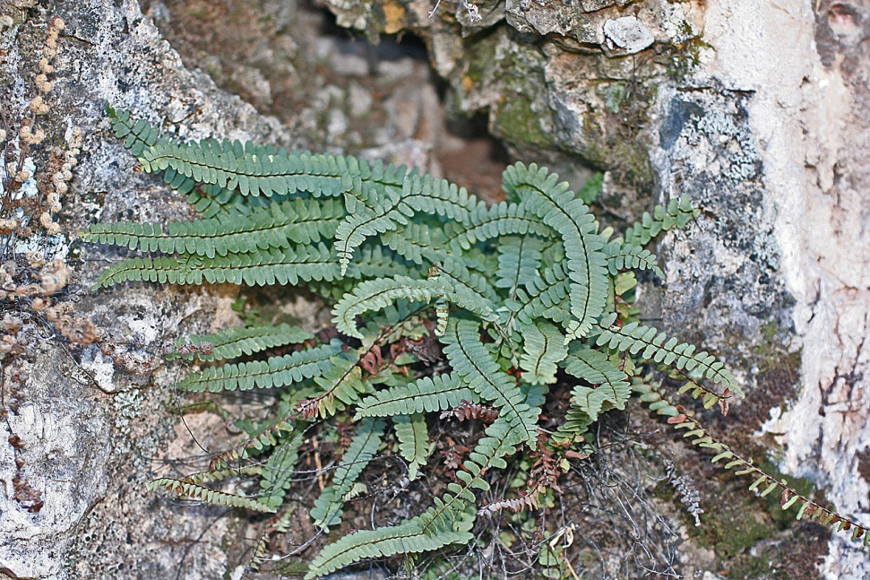
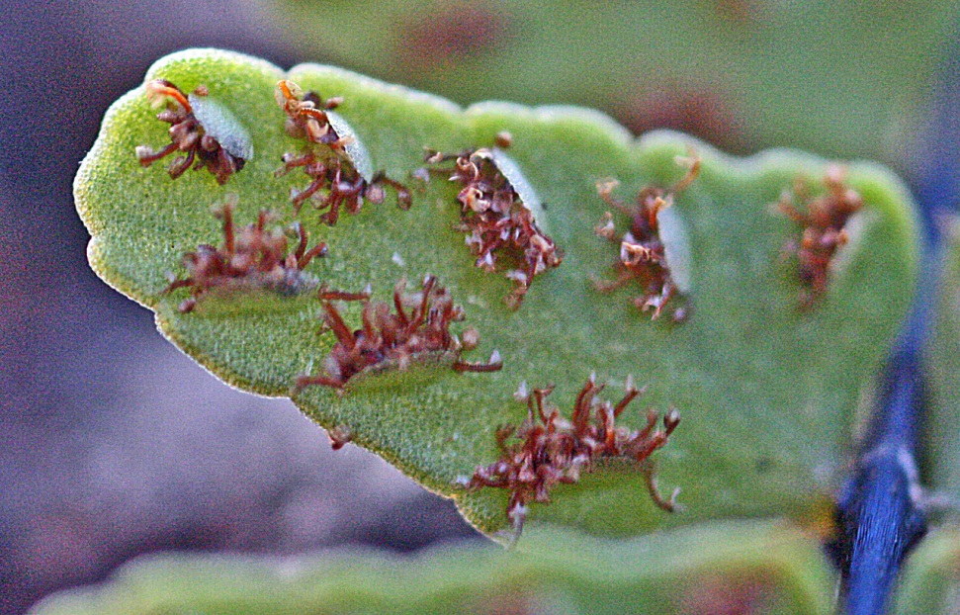
Asplenium resiliens (Aspleniaceae)
Growth habit
Sori & sporangia

Slide 20
Ferns in the Gila– Families
Aspleniaceae (Spleenwort Family) Athyriaceae (Lady Fern Family)
Azollaceae (Azolla Family) Cystopteridaceae (Bladder Fern Family)
Dennstaedtiaceae (Dennstaedtia Family)
Dryopteridaceae (Wood Fern Family)
Equisetaceae (Horsetail, Scouring Rush Family)
Marsileaceae (Water Clover Family)
Pteridaceae (Maidenhair Fern Family) Woodsiaceae (Cliff-fern Family)
Largest family by far in the Gila– most arid adapted!

Slide 21
Pteridaceae (Maidenhair Fern Family) in the Gila
Adiantum capillus-veneris (Southern Maiden Hair)
Argyrochosma fendleri (Fendler's Cloak Fern)
Argyrochosma limitanea subsp. mexicana (Southwestern False Cloak Fern)
Astrolepis cochisensis (Jimmyfern, Cochise Scaly Cloak Fern)
Astrolepis integerrima (Southwestern Cloak Fern)
Astrolepis sinuata (Wavy cloak Fern)
Astrolepis windhamii (Windham's Cloak Fern)
Bommeria hispida (Copper Fern)
Myriopteris aurea (Slender Lip Fern)
Myriopteris rufa (Eaton Lip Fern)
Myriopteris gracilis (Slender Lip Fern)
Myriopteris fendleri (Fendler Lip Fern)
Myriopteris lindheimeri (Fairy Swords)
Myriopteris tomentosa (Wooly Lip Fern)
Myriopteris wootonii (Wooton's Lip Fern)
Myriopteris wrightii (Wright Lip Fern)
Myriopteris yavapensis (Graceful Lip Fern)
Notholaena standleyi (Star Cloak Fern)
Pellaea atropurpurea (Purple Cliff Brake)
Pellaea intermedia (Creeping Cliff Brake)
Pellaea truncata (Spiny Cliff Brake)
Pellea wrightiana (Wright Cliff Brake)
Myriopteris (formerly Cheilanthes) is the largest genus, very arid (also called “xeric”) adapted.
Pellaea is the second largest genus, also very arid adapted.

Slide 22
Arid Adaptations of Ferns in the Gila
Extreme dessication tolerance– some ferns can survive after losing 76% of their normal moisture content (most plants die after losing 8-12%!)
Water absorption through scales, curling to expose them. Sometimes coated in farina.
Small fronds shaded with scales or hairs
Much reliance on asexual reproduction– apogamous triploids

Slide 23
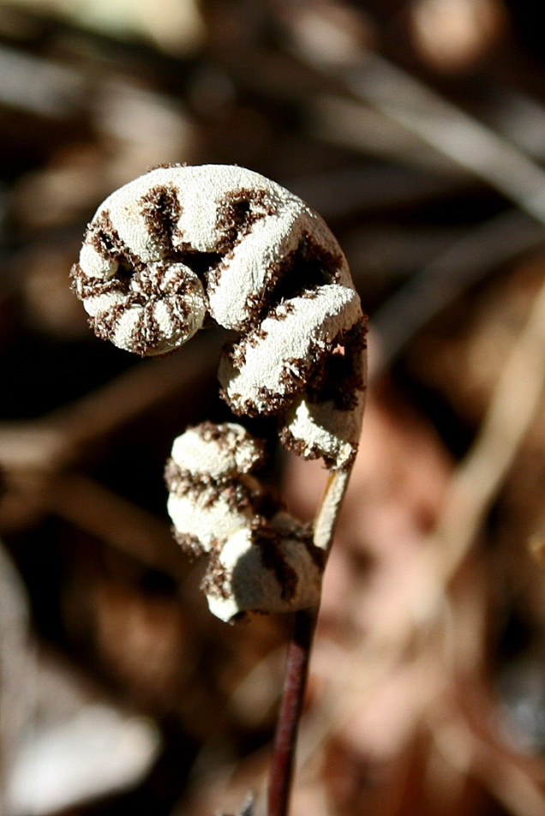
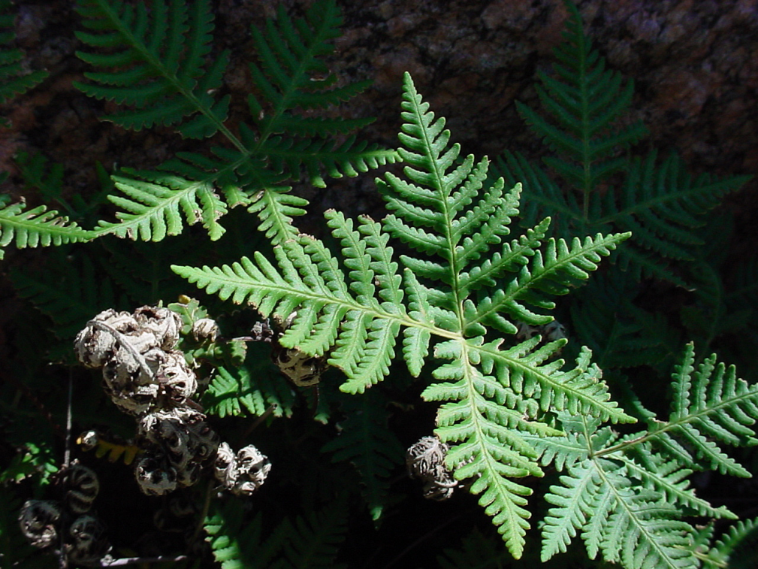
Arid Adaptation
Notholaena standleyi wet
Notholaena standleyi dry
Curling to expose water absorbing surface. Note farina.

Slide 24
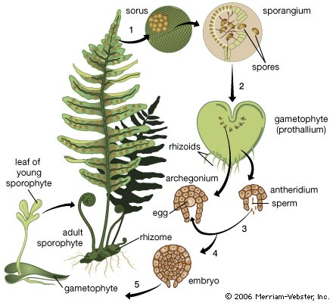
Fern Life Cycle
Alternation of Generations– more obvious than in Angiosperms (gametophyte not as reduced as in Angiosperms)

Slide 25
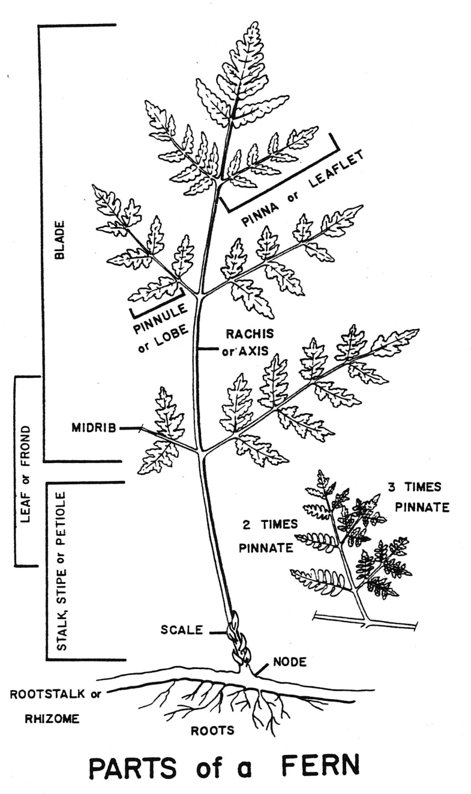
Fern Morphology

Slide 26
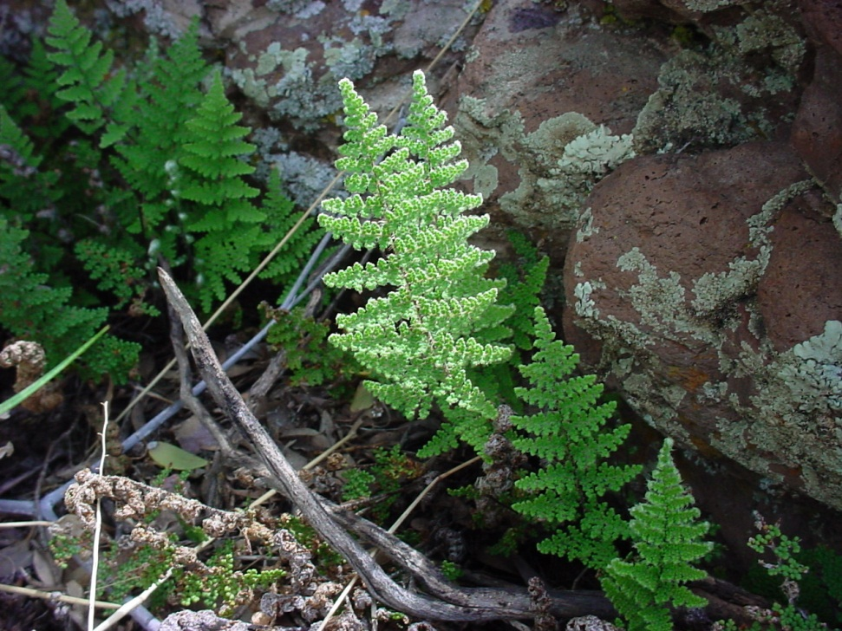
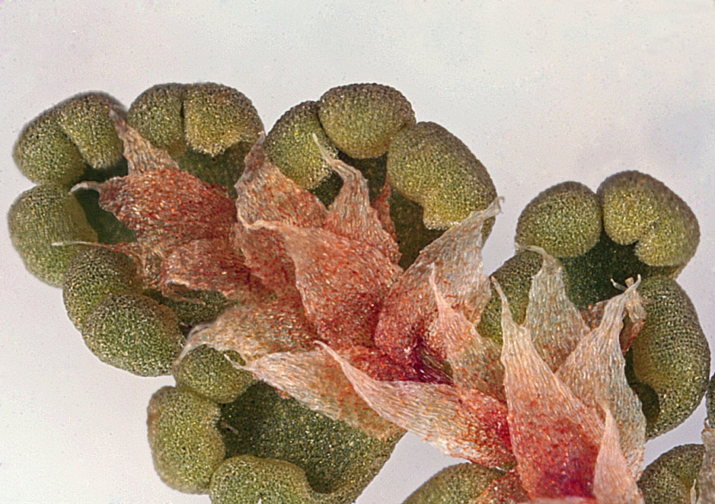
Myriopteris fendleri (Fendler’s Lip Fern)
Growth habit
Undersurface– scales (marginal sori hidden by false indusium)

Slide 27
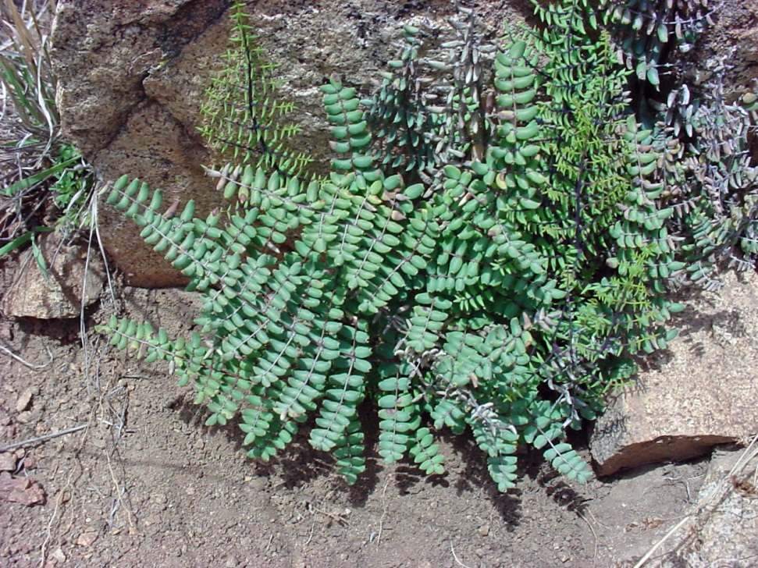
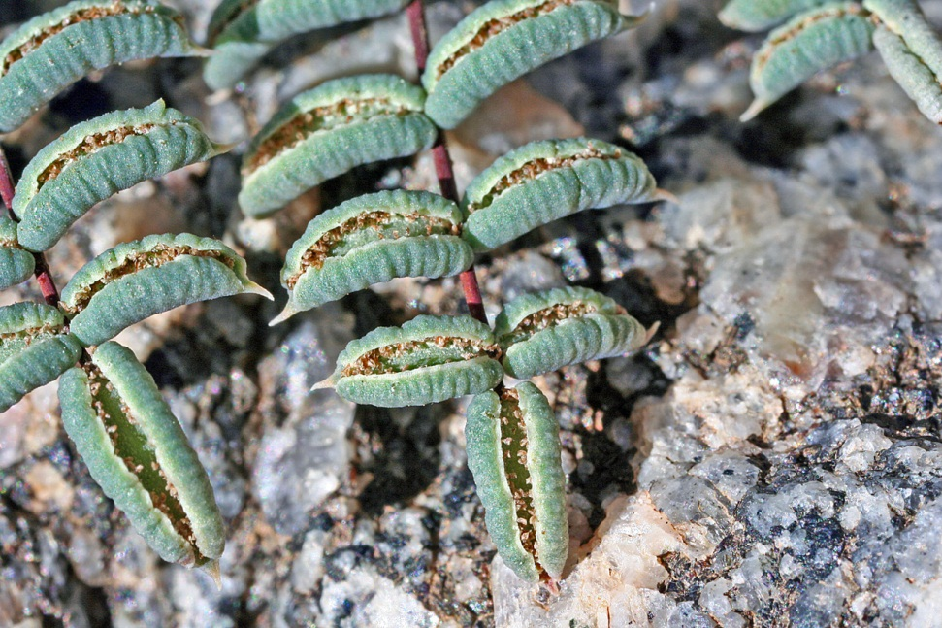
Pellaea truncata (Spiny Cliff Brake)
Growth habit
Undersurface of pinnule

Slide 28
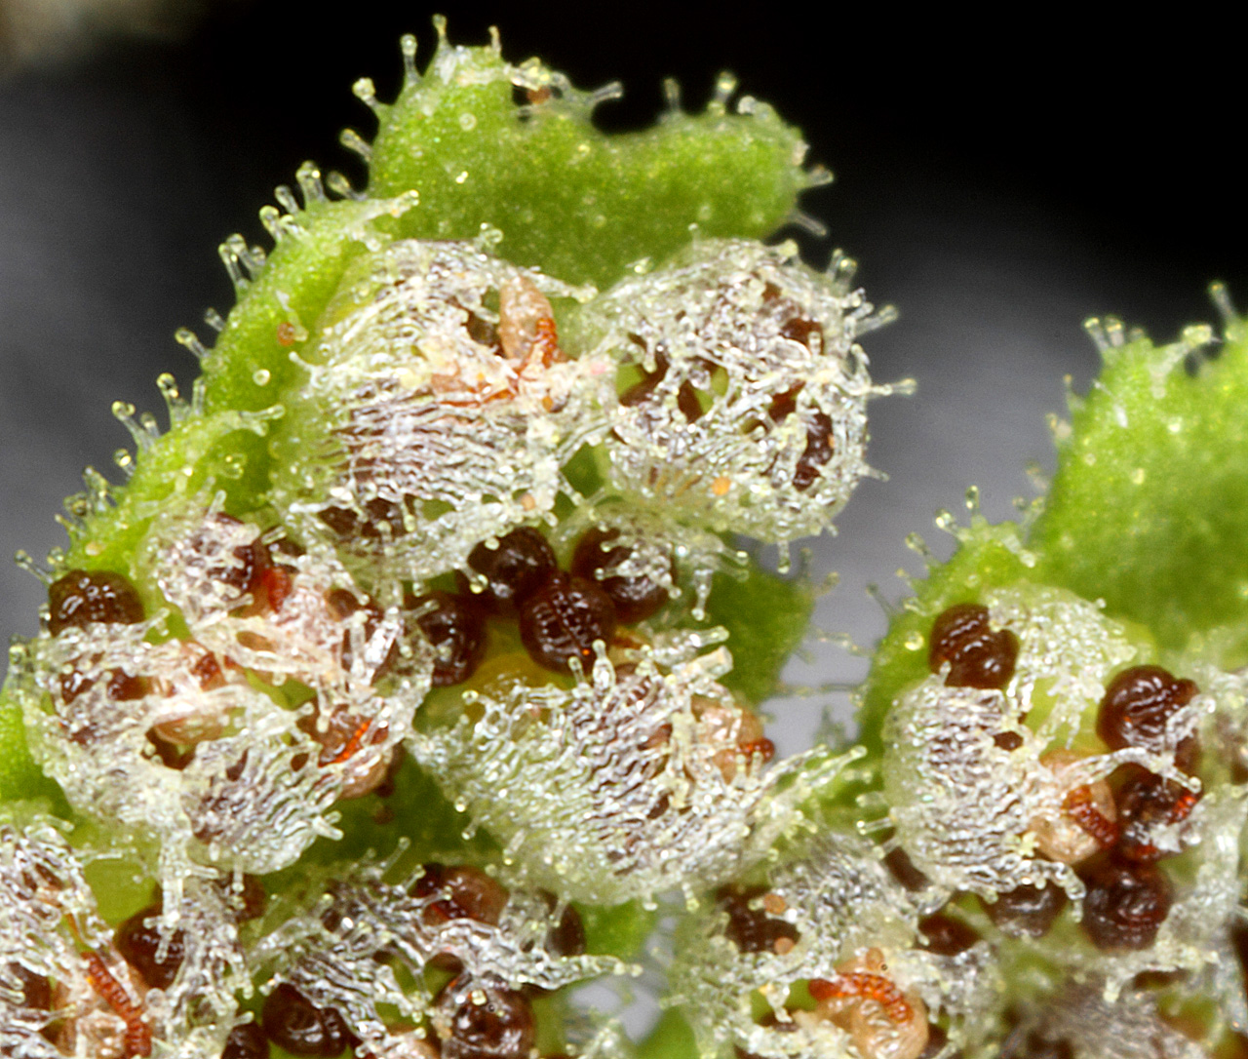
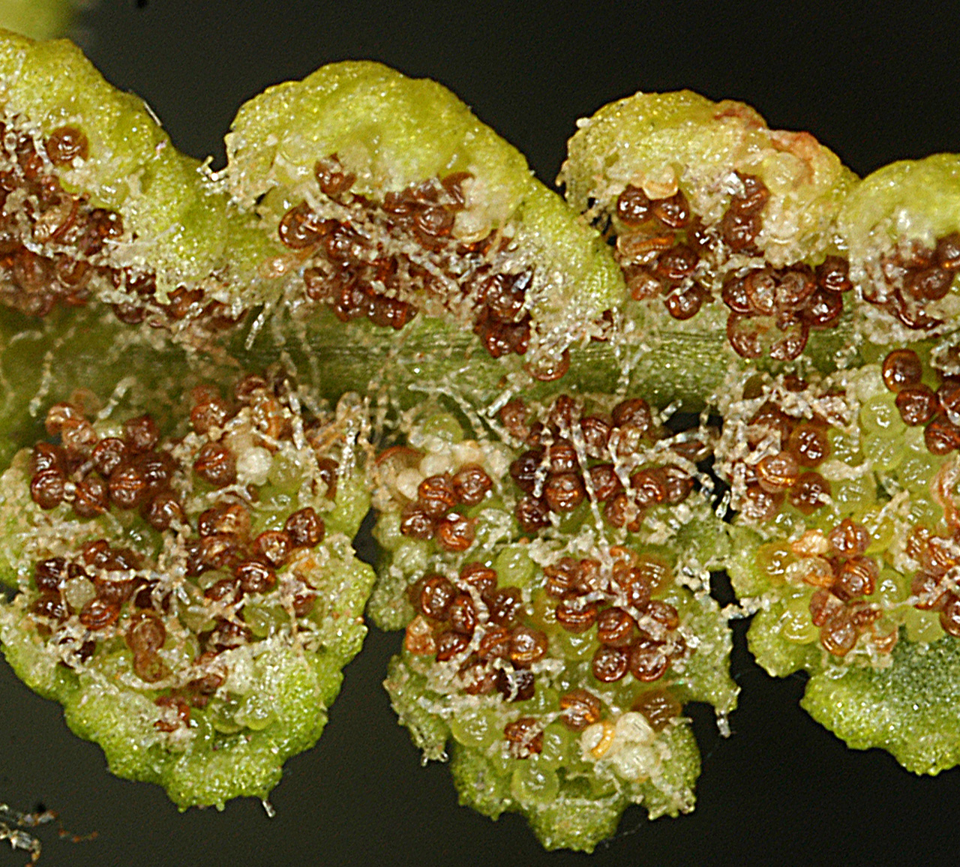
Woodsiaceae (Cliff Fern Family) in the Gila
Woodsia neomexicana (New Mexico Cliff Fern)
Woodsia phillipsii (Phillip's Cliff Fern)
Woodsia plummerae (Plummer's Cliff Fern)
Fronds turn brown and wilt for winter and new fronds grown rather than curling like Cheilanthes.

Slide 29
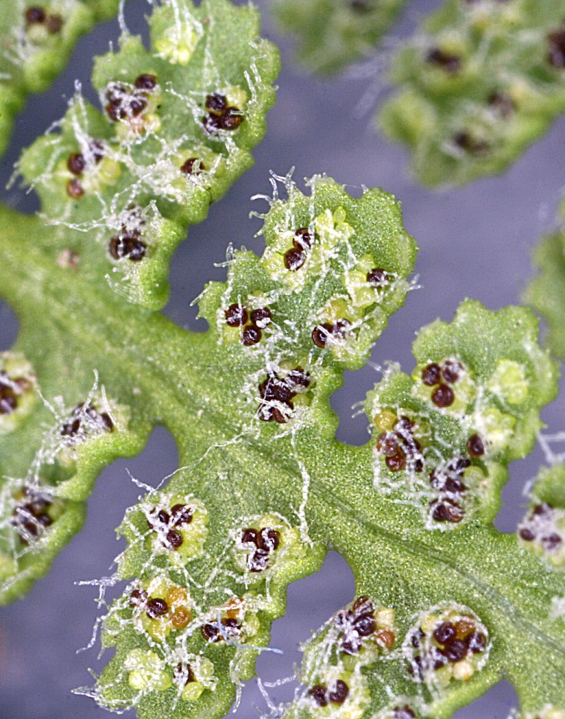
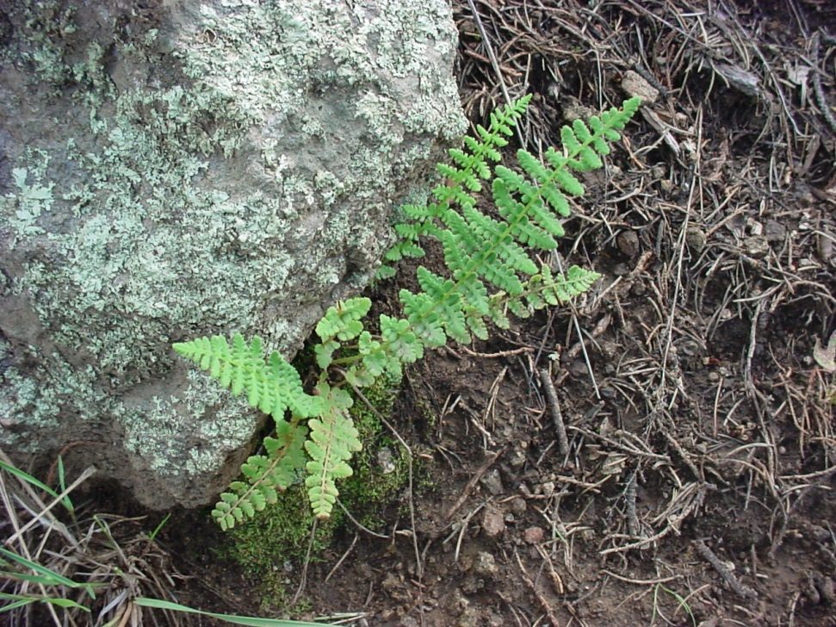
Woodsia phillipsii (Phillip’s Cliff Fern)
Growth habit
Undersurface of pinnule

Slide 30
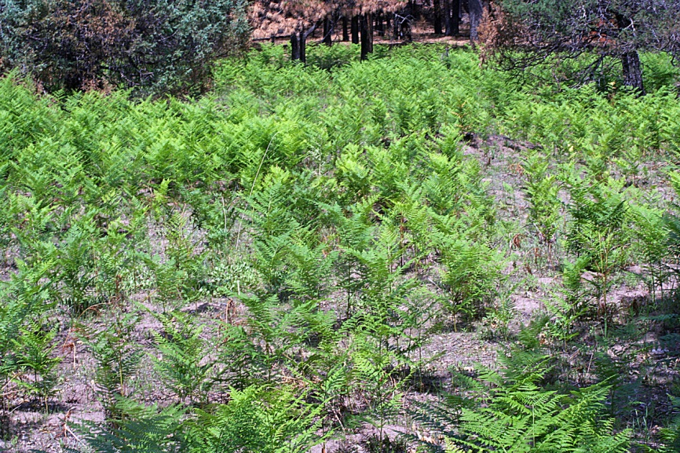
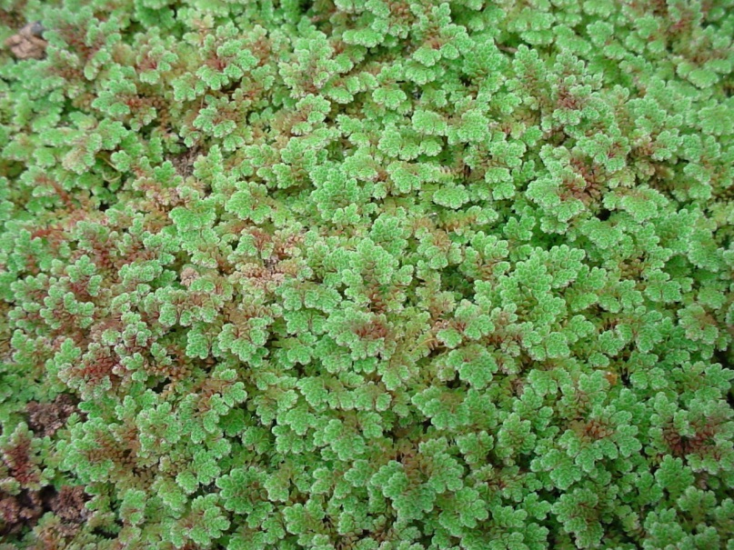
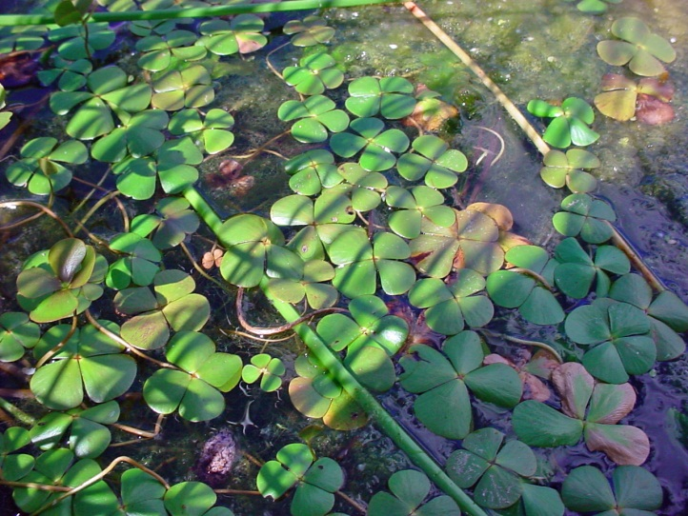
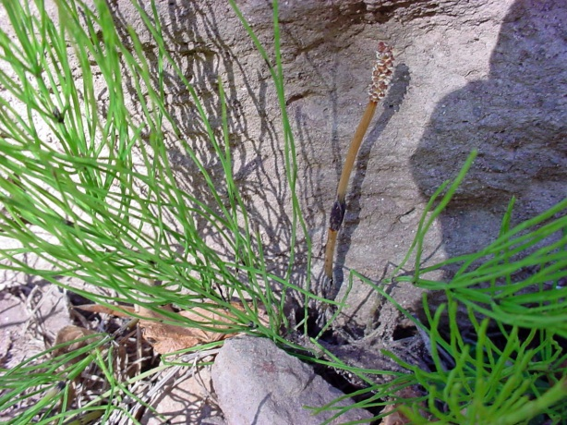
Other Fern Families (less well represented in the Gila)
Azolla mexicana—Mosquito Fern (Azollaceae)
Pteridium aquilinum– Western Bracken Fern (Dennstaedtiaceae)
Equisetum arvense (Field Horsetail) Equisetaceae
Marsilea vestita – Hooked Pepperwort (Marileaceae)

Slide 31
What Happens Next? Secondary Xylem (Wood) & Seeds!
On to the Acrogymnosperms!

